Slide 1
HR Analysis project
Comprehensive HR Insights Dashboard
Name : Nikhil Kumar Reddy
Email:nikhilkumarreddy1354@gmail.com
Course : CDA
Batch:10th Nov

Slide 2
Motivation to choose dataset
This dataset was selected because it provides comprehensive employee information across multiple dimensions such as location, department, gender, race, and hiring trends. It enables meaningful insights into workforce distribution, diversity, and organizational growth. By analyzing this data, we can identify patterns in hiring, departmental strength, and regional concentration, helping HR teams make data‑driven decisions to improve recruitment strategies, diversity initiatives, and employee retention.

Slide 3
Process of doing project
Data Collection – Gather the employee dataset containing details like age, gender, department, location, race, and hire dates.
Data Cleaning – Remove duplicates, handle missing values, and ensure consistent formatting for accurate analysis.
Data Transformation – Convert data types, create calculated columns (e.g., age groups, location categories), and prepare it for visualization.
Data Analysis – Use tools like Power BI or Tableau to explore patterns and relationships (e.g., hiring trends, diversity, department strength).
Data Visualization – Build interactive dashboards showing key metrics such as total employees, gender ratio, department counts, and location distribution.
Insights & Interpretation – Identify trends (e.g., most employees in Ohio, engineering as largest department) and draw conclusions for HR strategy.
Presentation – Summarize findings in a clear, visual, and professional PowerPoint deck for decision‑makers.

Slide 4
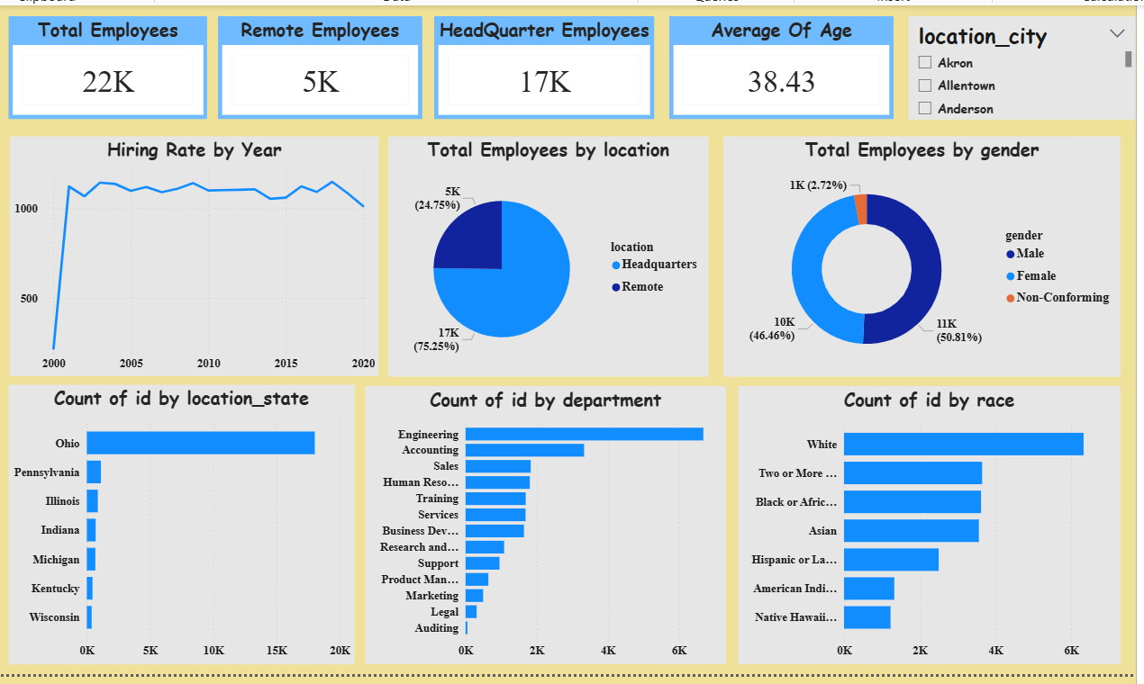

Slide 5
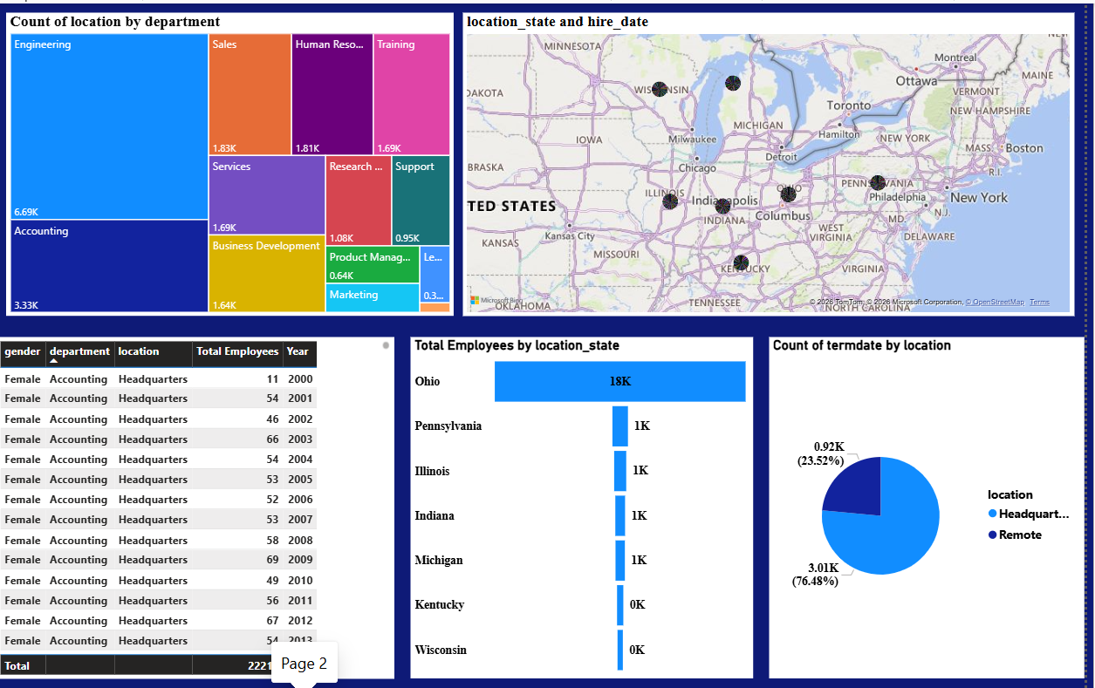

Slide 6
Key Insights
Total Workforce:
The company has 22K employees, with 17K at headquarters and 5K working remotely, showing strong centralization but growing remote flexibility.
Average Age:
The average employee age is 38.43 years, indicating a mature and experienced workforce.
Hiring Trend:
Hiring peaked around 2000 and remained stable over the years, reflecting consistent recruitment and retention.
Gender Diversity:
Workforce is well balanced — 51% male, 46% female, and 3% non‑conforming, showing inclusivity.

Slide 7
Location Distribution:
Ohio has the highest employee count (~20K), followed by Pennsylvania and Illinois, highlighting regional concentration.
Department Strength:
Engineering leads with the largest number of employees (~6K), followed by Accounting and Sales showing a strong technical foundation.
Racial Diversity:
Majority are White, with good representation from African American, Asian, and multiracial groups, indicating moderate diversity.
Remote vs HQ Ratio:
About 25% of employees work remotely, suggesting adaptability to modern work models.

Slide 8
Recommendations
Expand Recruitment Regions – Focus on hiring beyond Ohio to achieve a more balanced workforce distribution across states.
Enhance Diversity Programs – Strengthen initiatives to increase representation from underrepresented racial and gender groups.
Promote Remote Work Opportunities – With 25% of employees already remote, expanding flexible work options can improve retention and attract wider talent.
Invest in Engineering and Technical Training – As Engineering is the largest department, continuous skill development will sustain innovation and productivity.
Monitor Age Demographics – The average age of 38.43 suggests an experienced workforce; plan succession strategies to maintain knowledge transfer

Slide 9
Conclusion
The dataset provided a comprehensive view of employee demographics, including age, gender, race, department, and location.
Analysis revealed a strong concentration of employees in Ohio and a dominant Engineering department, highlighting organizational strengths.
Workforce diversity is improving, with balanced gender representation and moderate racial diversity.
Hiring trends show stability after 2000, reflecting consistent recruitment and retention practices.
Remote work adoption (~25%) indicates flexibility and adaptability to modern work models.
The average age of 38.43 years suggests an experienced workforce, requiring succession planning for future sustainability.

